Slide 1
online metro card recharge
GIRIJA PRASADA MALLIK

Slide 2
CONTENTs
User Interfaces
Hardware Interfaces
​Software Interfaces
Functional Requirements

Slide 3
Introduction
But then again, it is noticed that even though metro is a great service for all daily commuters, many problems are faced by them. One of them being, the long waiting queues of metro card recharge.
Thus, we have taken an initiative to solve the problem by providing an online portal to smart card users, so that they can recharge their metro cards online sitting at their homes and can avoid the long waiting queues.
This web application aims to provide the daily metro commuters with a platform to recharge the smart card online. It would require the user to register with the DMRC as well as on the application. The user can recharge the card using three methods: online net banking, credit/debit card and Paytm service. Users recharging can avail different offers (“Offers of the day “)
Other facilities like maps, balance enquiry, nearest metro station etc. are also available.
DMRC has a fully automatic fare collection system and issues Smart Cards for multiple journeys and Smart tokens for single journeys. The Smart card can be recharged at customer care centers of any metro station and is valid for one year from the day of last recharge.

Slide 4
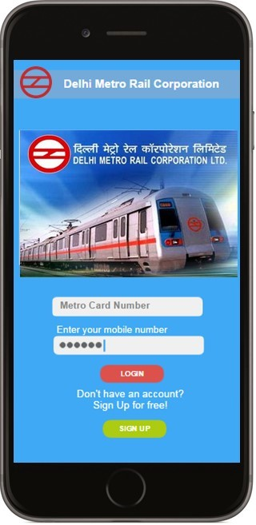
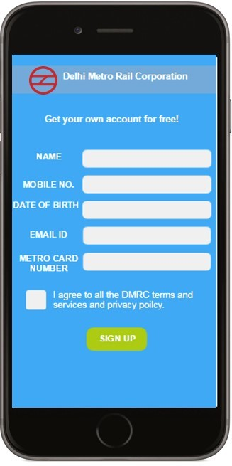
User Interfaces
Login and Signup Interfaces:

Slide 5
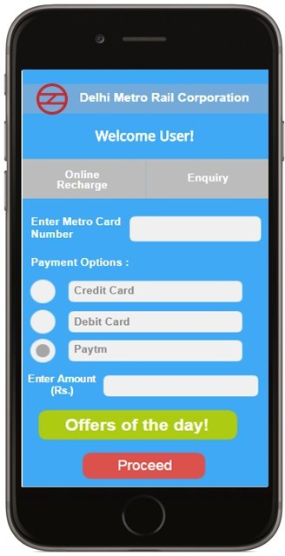
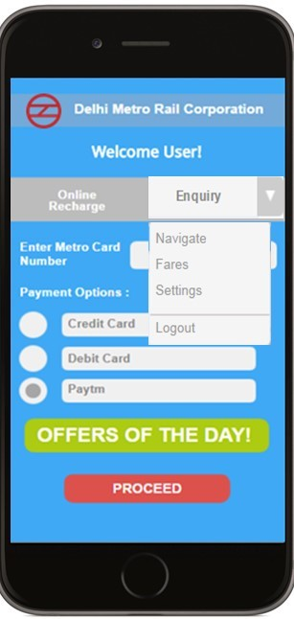
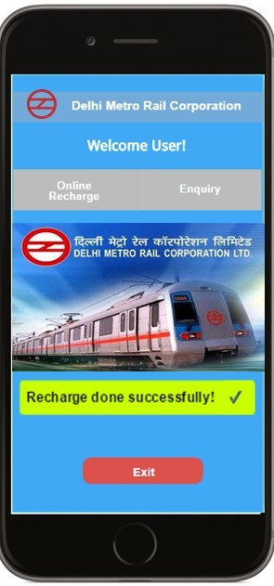
User Interfaces
Online Payment and Enquiry and Success Interfaces:

Slide 6
User Interfaces
Login and Signup Interfaces:

Slide 7
Hardware Interfaces
We require a nominal display; high deficiency screen is not necessary. Also, internet connection is required to support the online payment and data manipulation in the DMRC database.
Also we need a special RFID punch facility available to users which is secure enough to allow user to recharge their card simply by just pressing the card over it.

Slide 8
Software Interfaces
We require a special database known as “USER INFO” which is available to the application and the DMRC admin so that the user with a metro card can register on the application and get the services.
Also we need a small file known as “Metro details” which contain the data about the metro stations and the line code on which it is located and the fare table as well.

Slide 9
Hardware Interfaces
We require a nominal display; high deficiency screen is not necessary. Also, internet connection is required to support the online payment and data manipulation in the DMRC database.
Also we need a special RFID punch facility available to users which is secure enough to allow user to recharge their card simply by just pressing the card over it.

Slide 10
Functional Requirements
FR 1: Signup
Inputs: Name, DOB, mobile number, email Id, Metro Card Number
Output: It does not produce output, Account is created
The function simply calls a module acquire ( ) which gets all the input required to sign up and register with the application. The data passed is validated further by simply calling validate ( ) module which can connect to the database and match that whether the entered metro card has been sold or not and feeds the data into the database if the user is validated.

Slide 11
FR 2: Login
Input: Metro Card Number, Mobile Phone Number Output: No output
The function simply acquire the data and calls the module validate () which matches the details of the user and validates whether the user is authenticated or not.
FR 3: Online payment
Input: Valid data (record read), Metro Card Number, Payment Option, Amount, Rebate option
Output: Payment (to DMRC)
This function acquires the necessary bank details and then connects to the respective banking for online money transfer through a safe portal using the connect ( ) module , further when the bank transfers the money as payment it is passed to the process ( ) module which then collects the details of the users current balance and adds the amount transferred into the balance and sets a flag to indicate a new payment to the RFID punch machine.

Slide 12
FR 4: Enquiry
Input: Option(=navigate/=fare/=setting/=logout) Output: Display the data according to the input
The Enquiry module has various sub modules according to the option selected by the user and accordingly other processing modules to process the requested output.
FR 5: (Enquiry) Fare Calculator
Input: Metro station name1, Metro Station Name 2 Output: Metro station distance, Route, Fare, Time
The function calls an input ( ) module to acquire the data and then calls a process ( ) function which will produce the output required and sends it further to display ( ) module.

Slide 13
FR 6: (Enquiry) Navigate Input: Place Name Output: Metro station
The function calls an input ( ) module to acquire the data and then calls a process ( ) function which will produce the output required and sends it further to display ( ) module.
FR 7: (Enquiry) Setting Input: various options Output: Confirmation
The function calls an input ( ) module to acquire the data and then calls a process ( ) function which will produce the output required and sends a confirmation further to display ( ) module.

Slide 14
THANK YOU

